Slide 1

How to Choose the Right Snowboard?
Artg 5430 final project
By Limin zhang

Slide 2
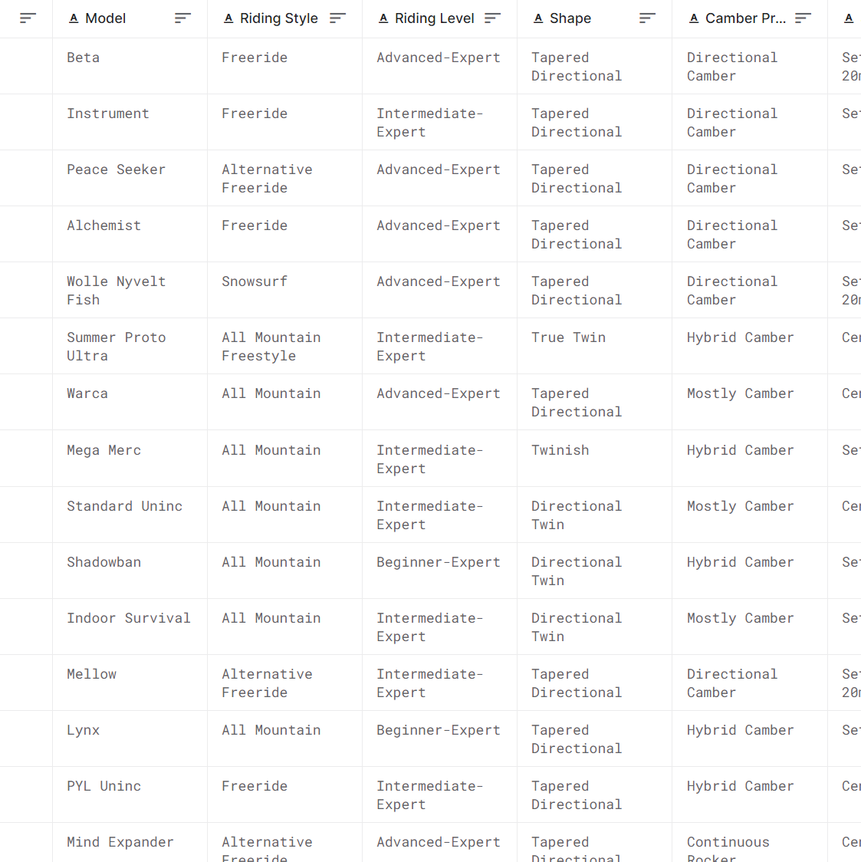
Introduction
Goal of the project:
Picking the right snowboard is an important first step to an enjoyable snowboarding experience. However, snowboards come in a variety of widths, lengths, profiles, and more. People might be overwhelmed by the handful of options.
My goal is to help the viewers with limited snowboarding experience understand the factors for choosing the RIGHT snowboard.
Also, because of the poor snow condition in new England area, the other goal is to help experienced riders pick a snowboard that is best for powder condition.
Dataset:
https://www.kaggle.com/datasets/oznbgcvn/snowboardpowdervalue?resource=download
The dataset collects data from 45 most common snowboard brands, altogether 390 models for men's snowboard, combined with corresponding information in riding style, riding level, snowboard shape, camber profile, stance, flex, price and powder rating which gives us a lot of information to analysis what makes a good powder snowboard.

Slide 3
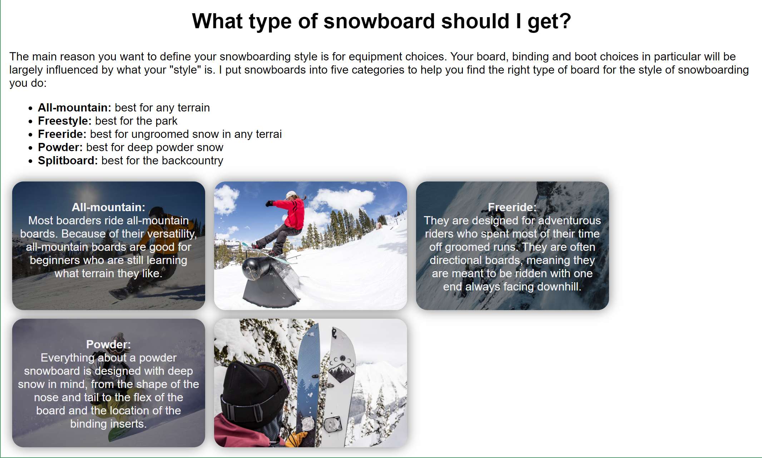
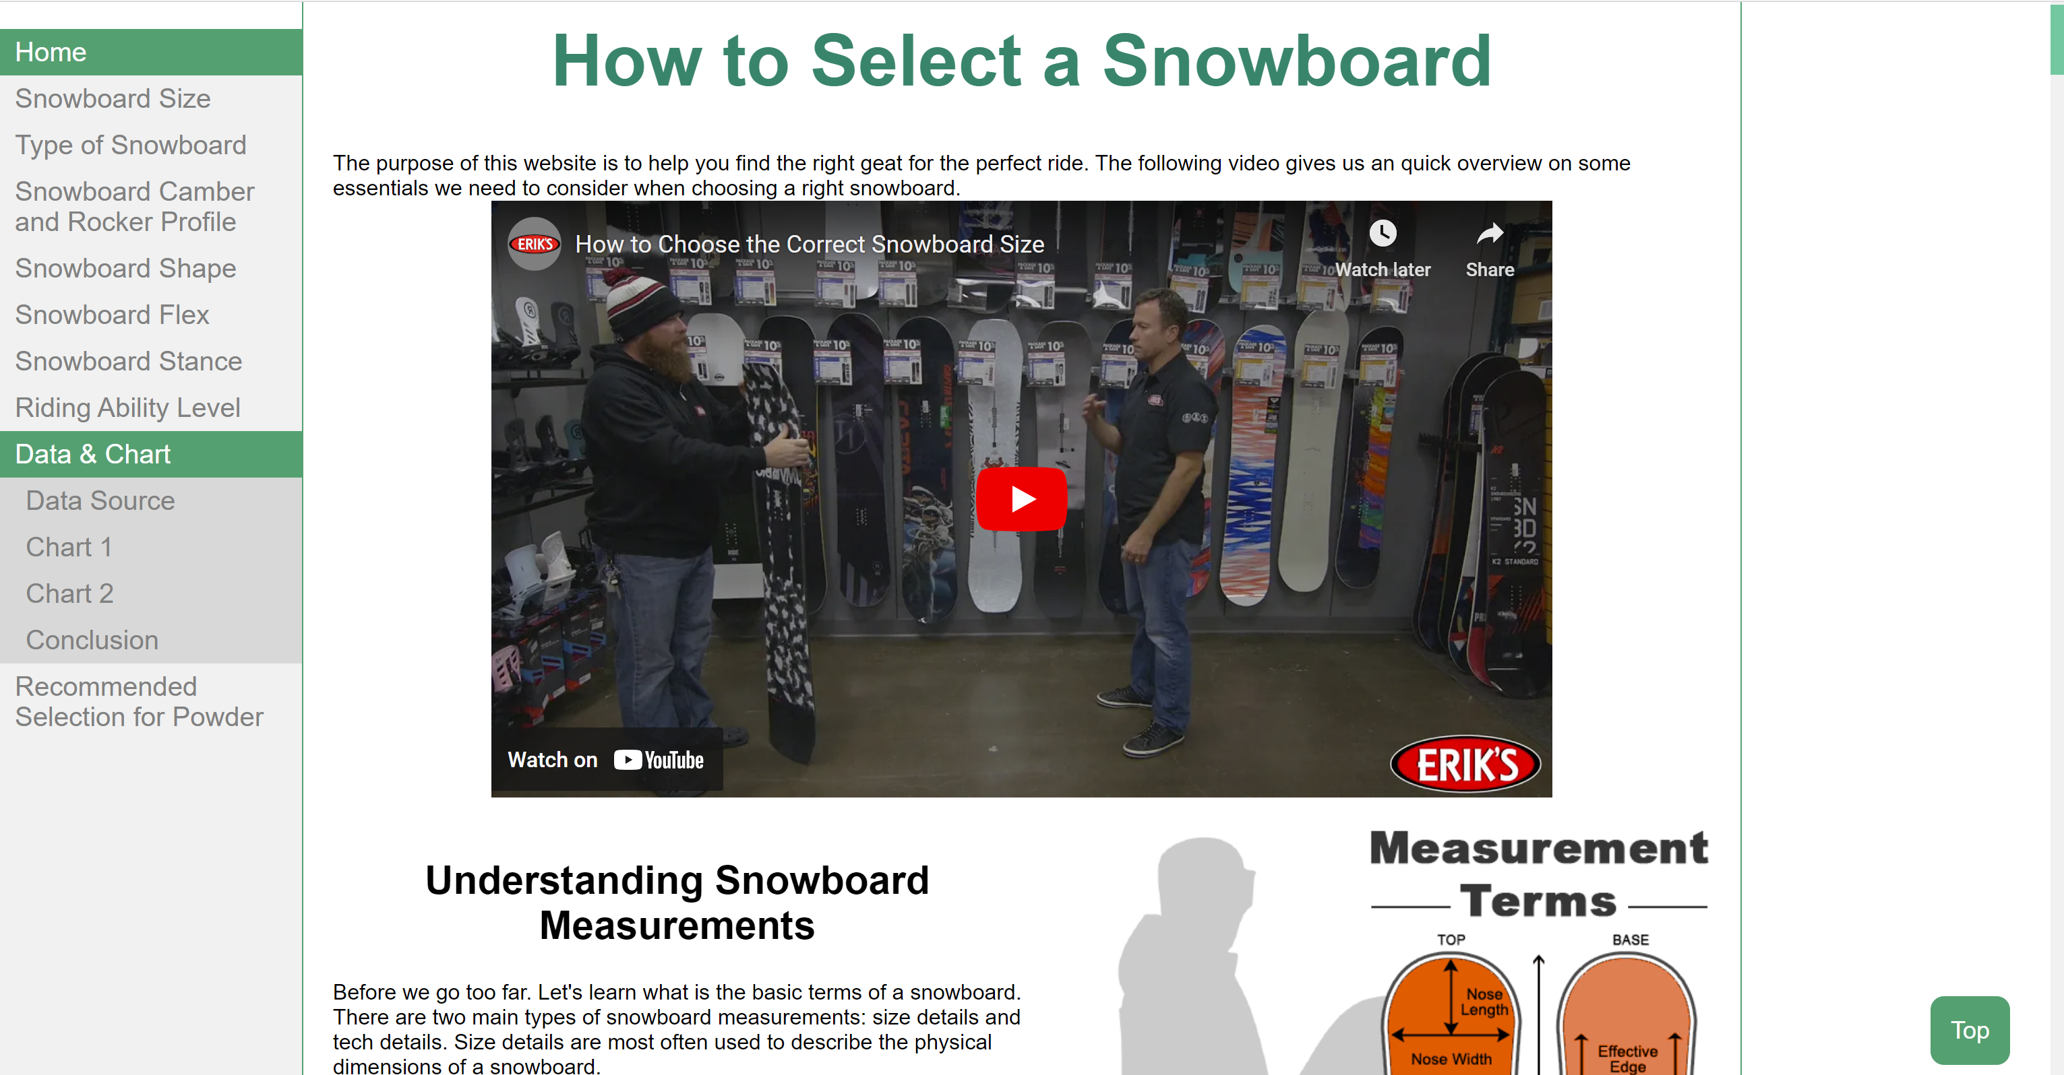
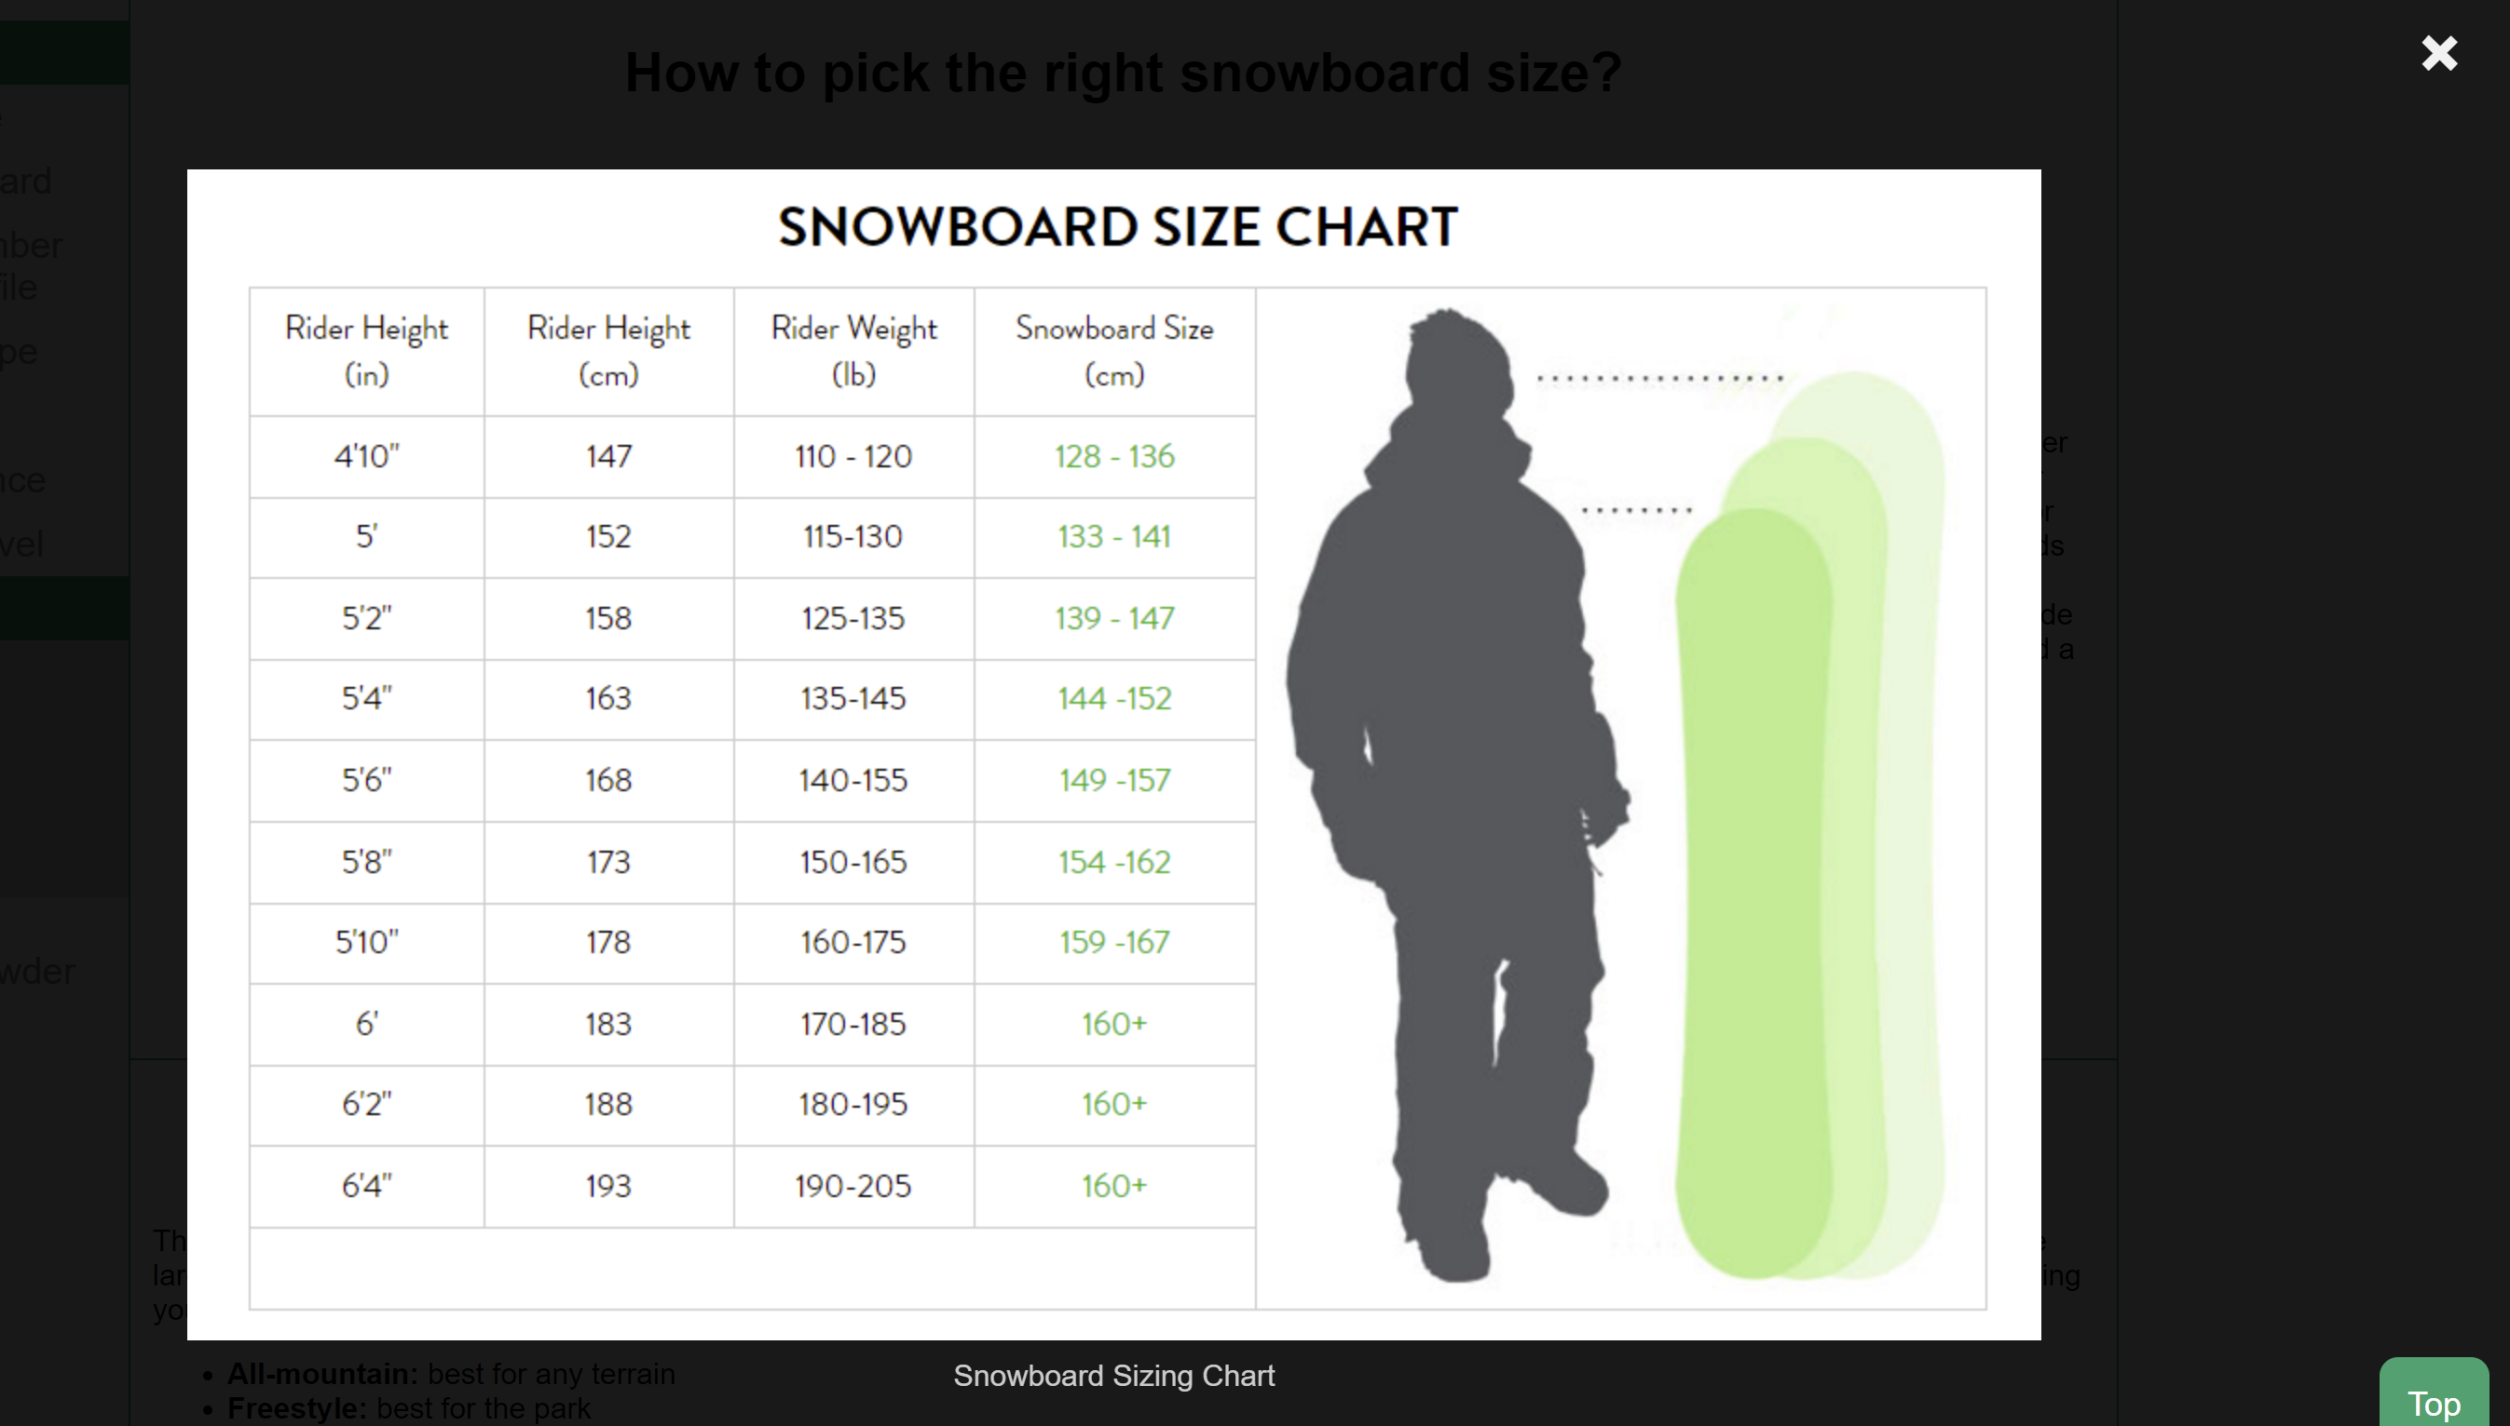
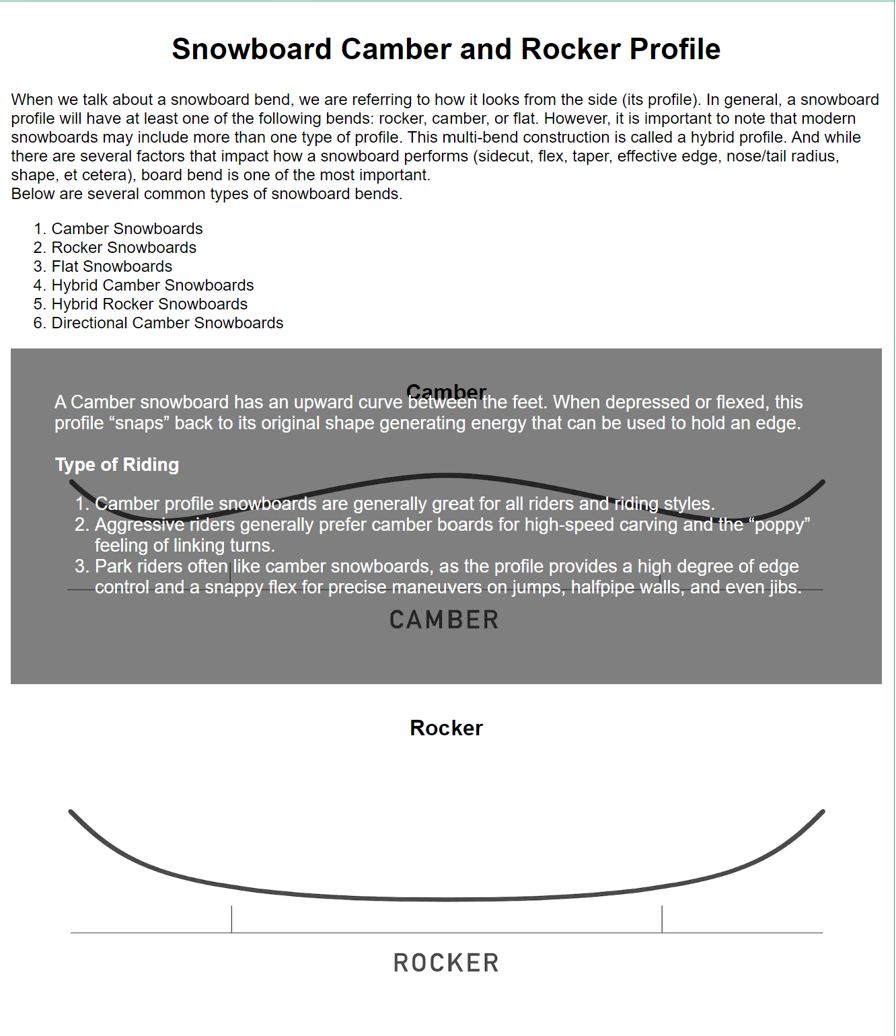
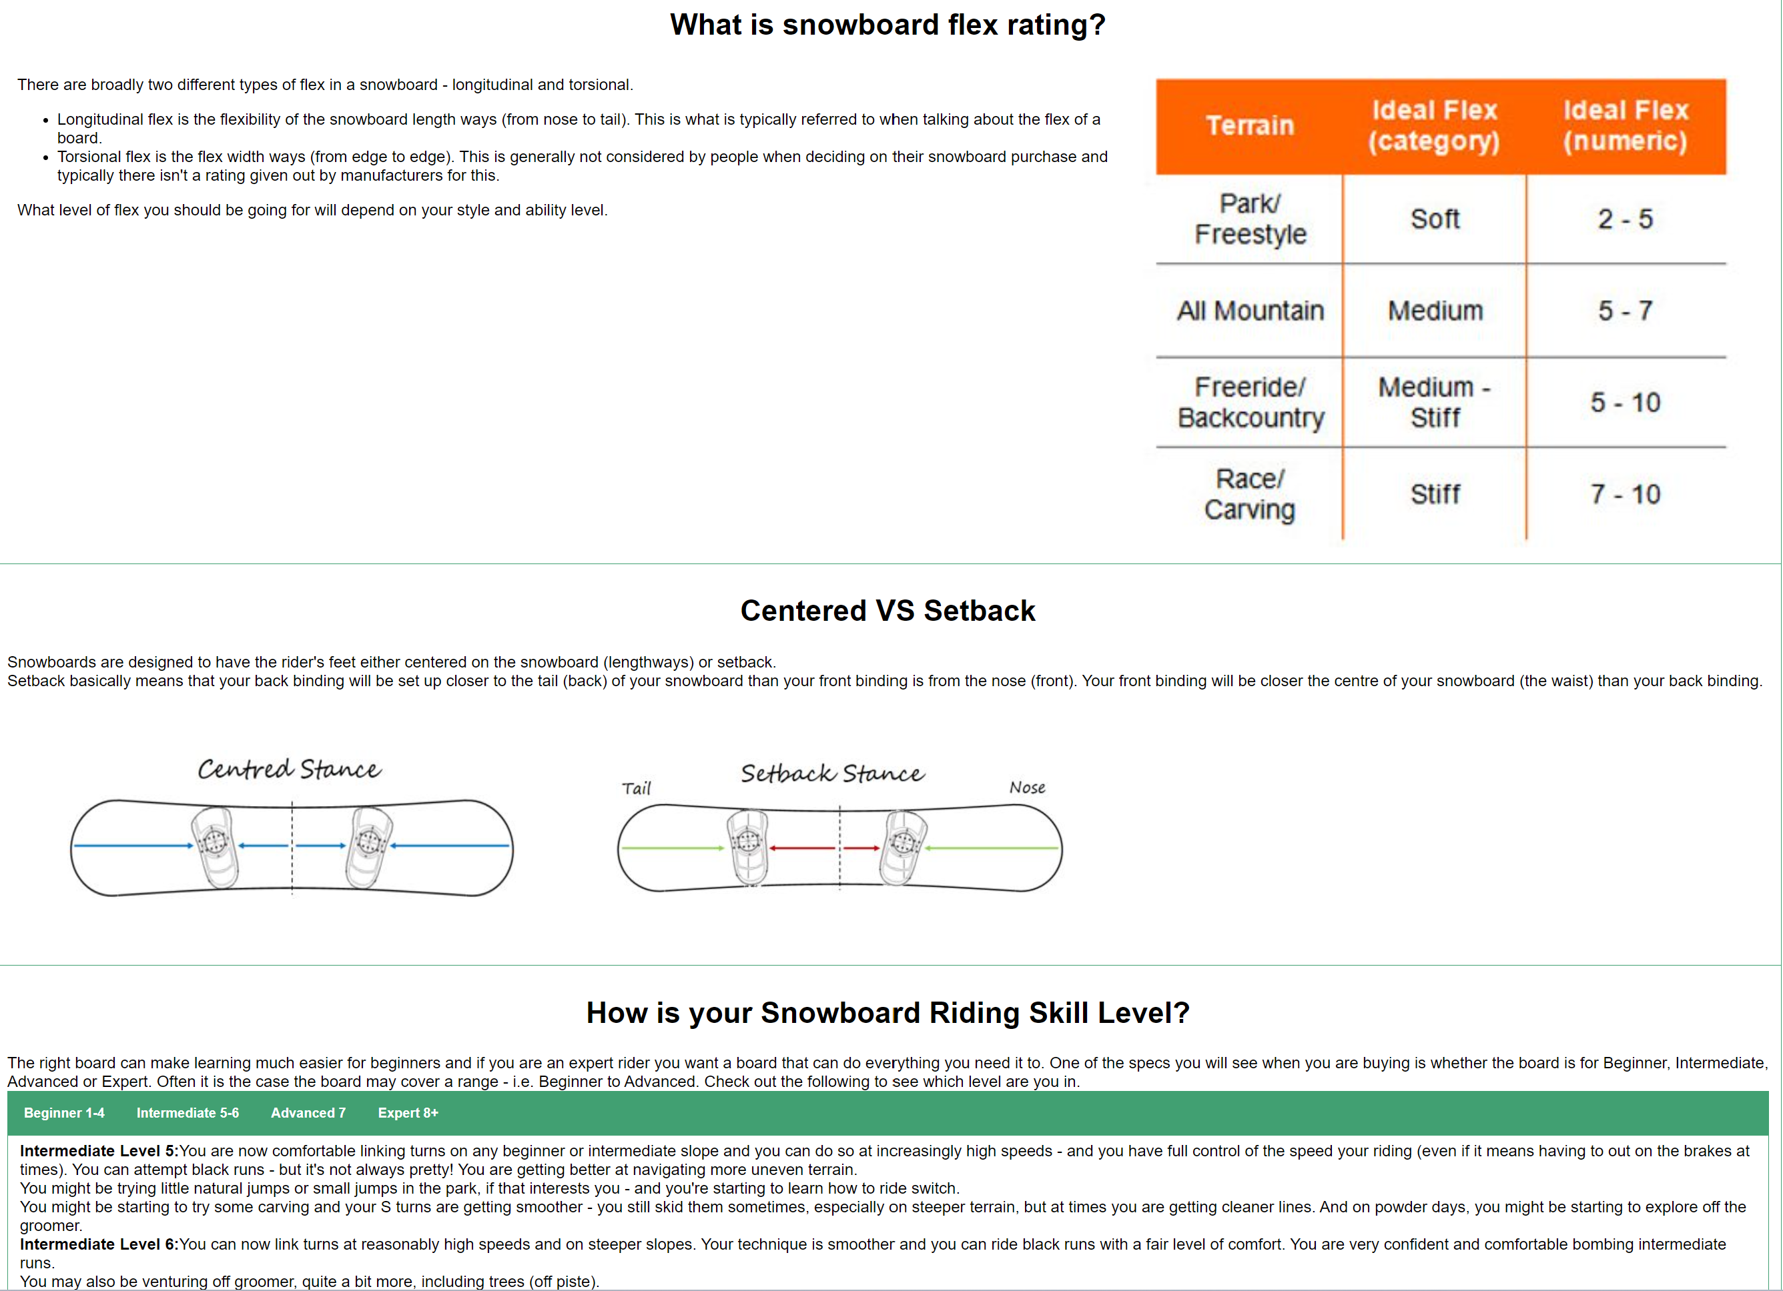
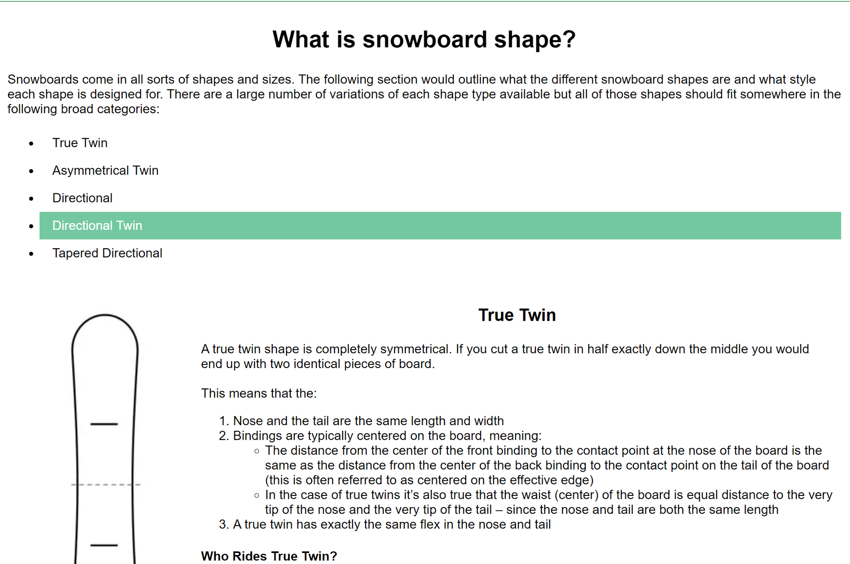
Demonstration
Homepage Link https://felicia-z.github.io/homepage
Final Project Link https://felicia-z.github.io/hw/hw5/

Slide 4
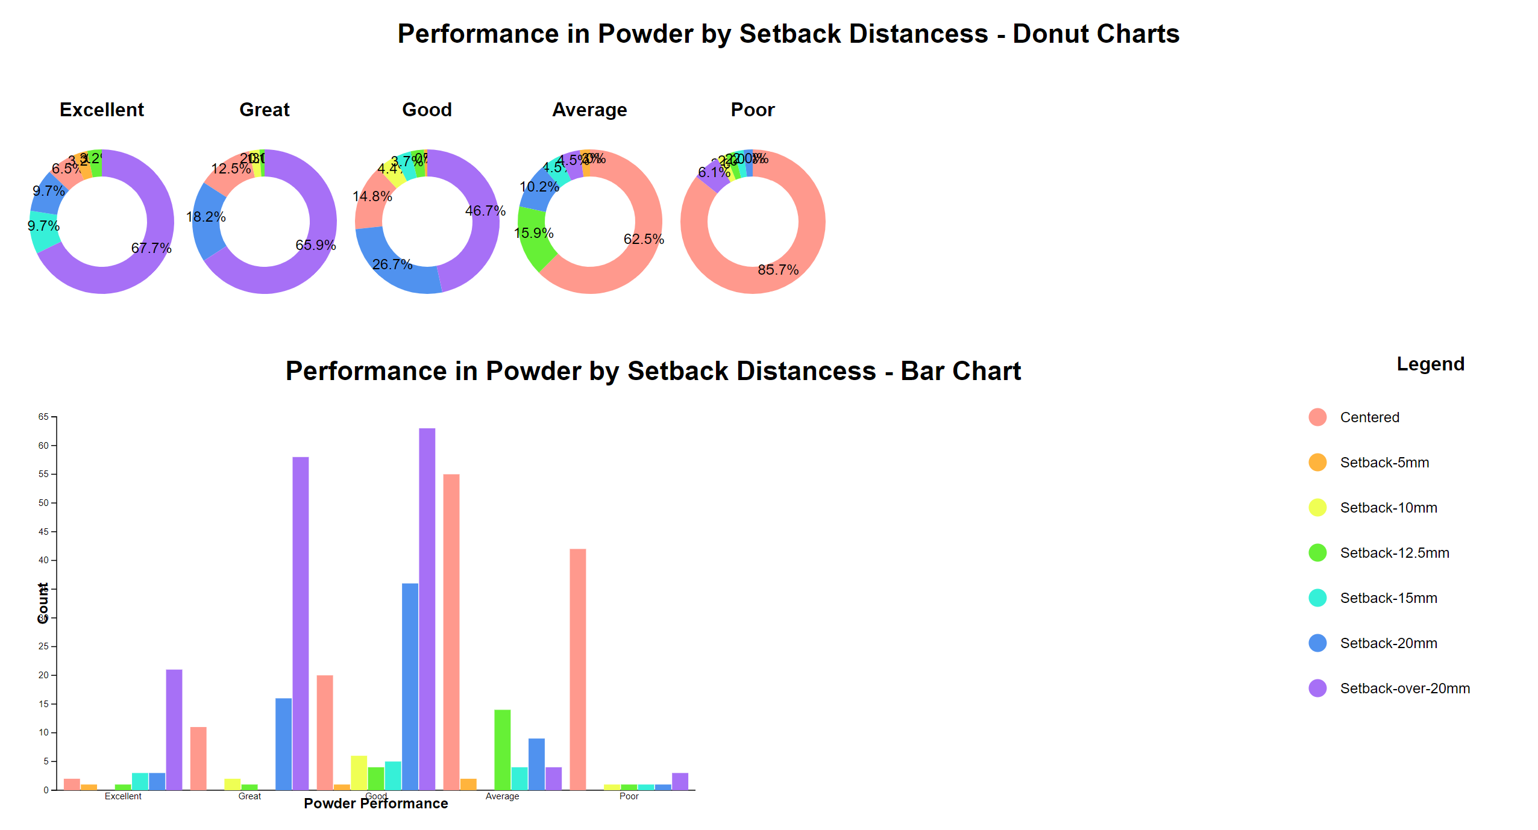
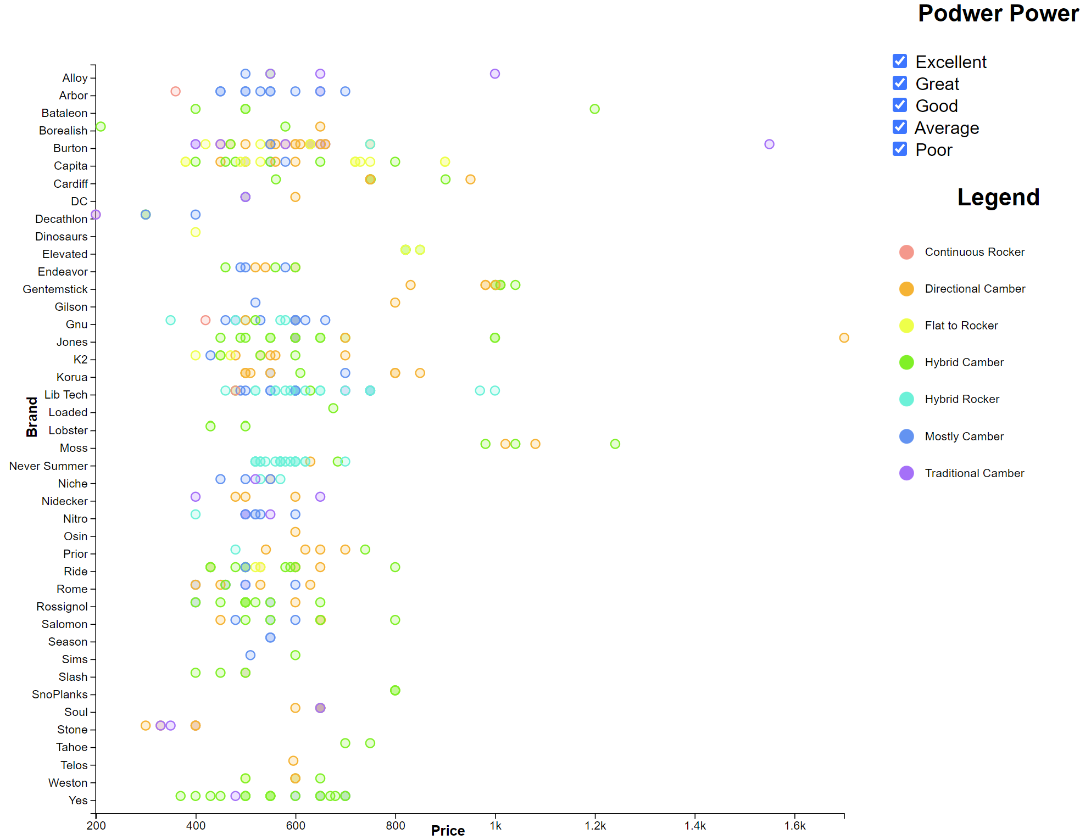
Demonstration
There are several features that make the board especially good for powder.
Setback: From the first and second charts above we can tell that a good powder snowboard usually has a setback stance. This setback stance will let you use a normal stance on less snowy days and then move your stance back for deep days.
Rocker: From the third chart we can tell that the most dedicated powder boards have large rockers in the nose or full rocker profiles. Boards with camber and reverse camber are more likely to cut into the snow and send the board down below it rather than let you float on top of it. Camber is great for ice and hard pack.
Other features: Wider and shorter board, Taper, Longer nose and shorter tail, Directional shapes, Soft to medium flex, etc.

Slide 5
Discussion
Key design decisions:
More general information to make the entire content more intuitive and friendly to readers with different experience level
More user interactive buttons to keep readers engaged
Try to make this website more adaptive by add an alternative for each image and increase the contrast
Exploratory data analysis
Most board with poor powder performance are freestyle boards, however there are two freeride board also have poor powder performance. After explore more on those two models, I found out the reasons. First, they are too stiff to maneuver at low speed. Second, the nose and tail width is too narrow to provide enough buoyance. Third, the camber profile make them easy to catch edge. They are good boards for carving though.
I don’t really need to adjust the dataset except for some brand names and model names.

Slide 6
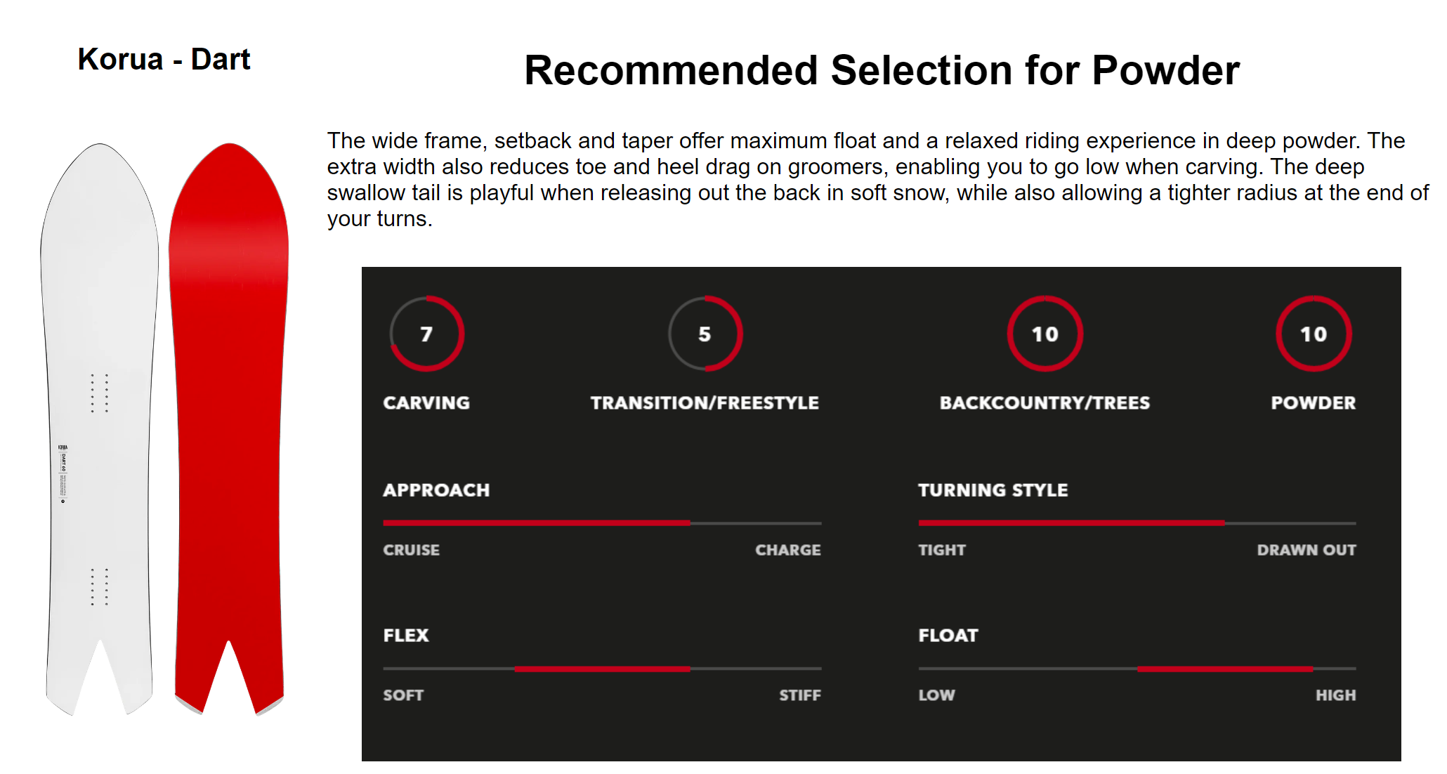
Future
More diversity in visualization.
I am planning to make those two charts more user interactive, such as click on one part of the donut chart and the corresponding bar in the bar chart would be highlighted.
Also, I am planning making a radar chart to represent the snowboard spec.
Instead of the general information and data from the chart, maybe include more scientific analysis is a good idea for advanced riders.

Slide 7

Thank you for your attention

